Slide 1
Google Docs-The Basics

Slide 2
General Navigation
Parts of the doc:
Document Title
default-Untitled document
Click to change name
Navigate to Google Docs Home Screen
Menu Toolbar
Menus lead to commands and options
Saved Changes Notification
Docs automatically saves changes as you work
Collaboration Tools
Ruler
Shortcuts Toolbar
Shortcuts for formatting the document

Slide 3
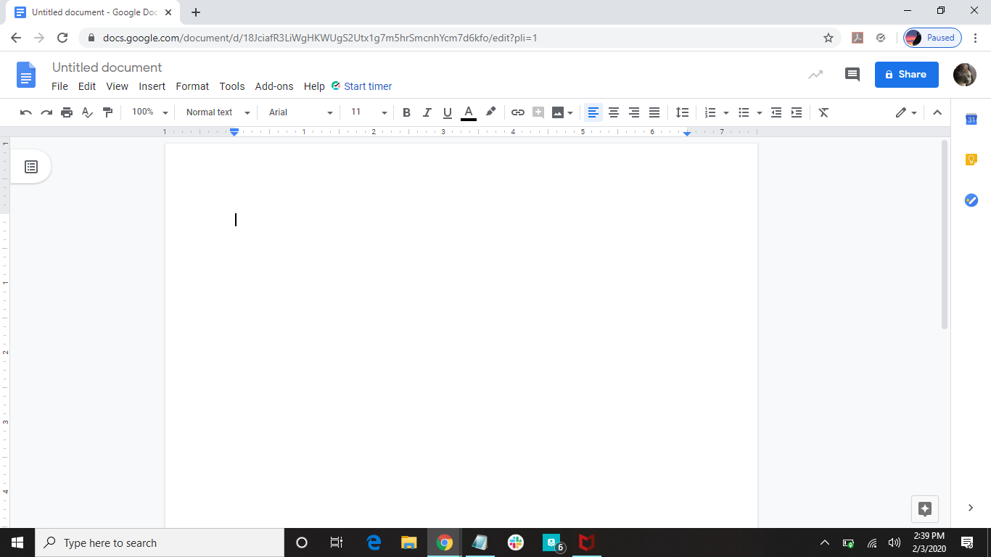

Collaboration Tools
Menu Toolbar
Document Title
Navigate to Google Docs Home Screen
Shortcuts Toolbar
Rulers

Slide 4
Menus
File
Edit
View
Insert
Format
Tools
Add-Ins
Help

Slide 5
General Information
If you are familiar with Microsoft Word, you will find Google Docs fairly easy to navigate
Google Docs works best when you use computer shortcuts for copy, cut, and paste
Special characters-look through all the symbols or search for a symbol
copy | ctrl+C
cut | ctrl+X
paste | ctrl+V

Slide 6
Print Preview/Printing
Click on File tab
Click on Print
Make changes for how the document should print
OR
Click on the printer symbol

Slide 7

1. Click here
Scroll down

Slide 8
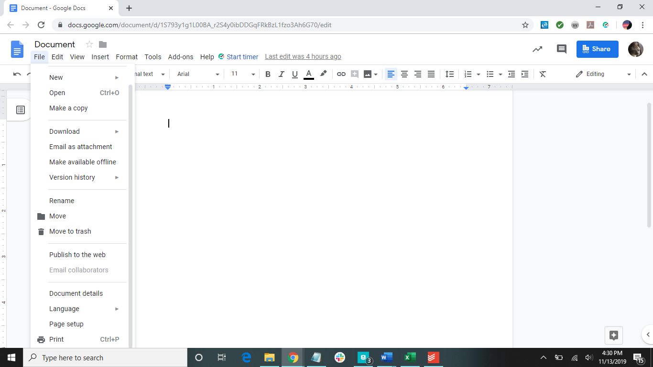
2. Click here

Slide 9
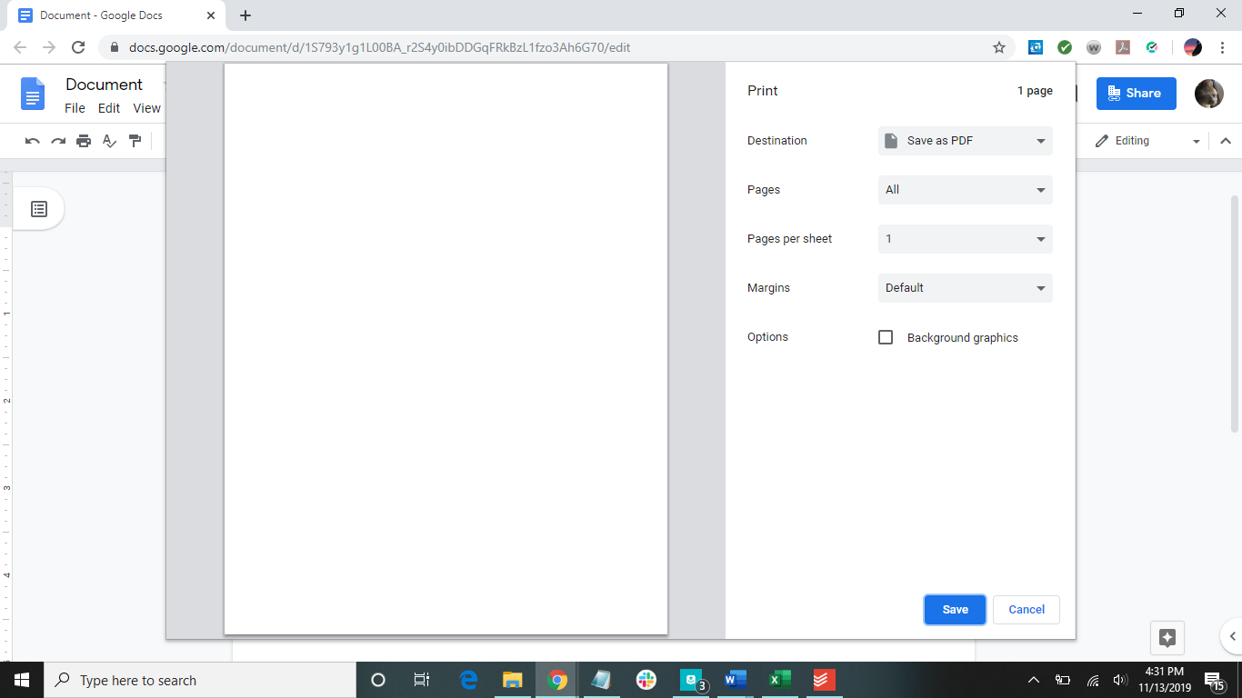
Choose how you want the document printed in the print settings to the right.

Slide 10
Download File
Click on File
Click on Download
Choose what kind of file you want the document to be downloaded as

Slide 11
1. Click here
2. Click here

Slide 12
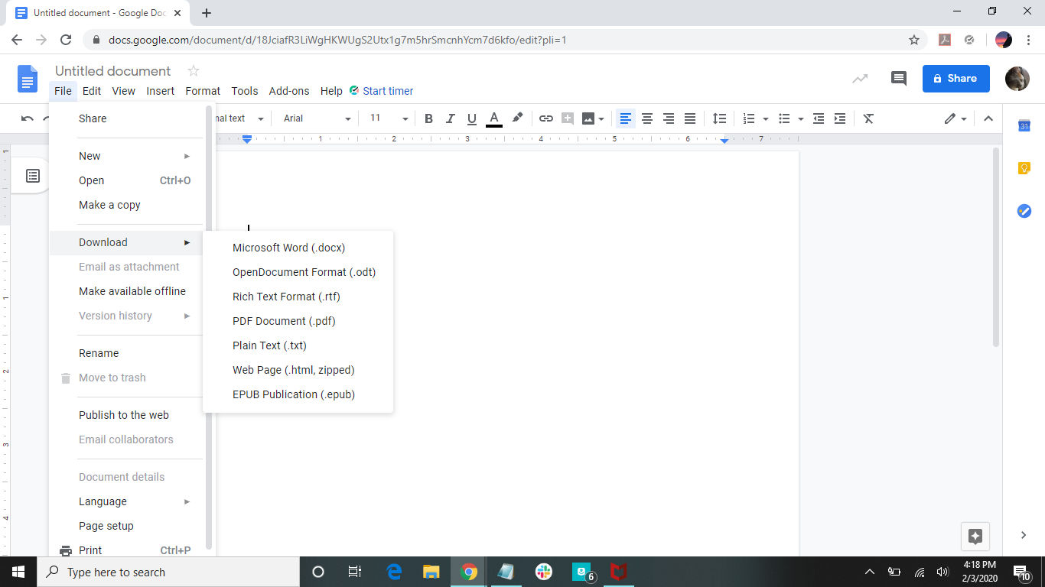
3. Choose which format you want

Slide 13
How to Add a Header/Footer
Click on Insert
Click on Header & page number
Choose which you would like:
Header
Footer
Page number
Page count
In order to have a page number and a header title, choose page number and add the title to that.

Slide 14

1. Click here
2. Click Here
or
Click here

Slide 15
Assignment
The challenge problems have been added as assignments in this presentation for this section.
Format a Works Cited page for the following links (using hanging indents) in APA format:
https://news.mit.edu/2021/exploring-future-humanitarian-technology-0603
https://gadgets.ndtv.com/laptops/news/microsoft-windows-next-generation-launch-announcement-date-june-24-event-invite-ceo-satya-nadella-build-2021-2455234

Slide 16
Helpful Shortcuts
ctrl+I | italicize
ctrl+B | bold
ctrl+U | underline
ctrl+C | copy
ctrl+X | cut
ctrl+Z | undo
ctrl+V | paste
ctrl+F | find

Slide 17
Have more questions?
Email us at ccla@doane.edu or come visit us in Communications 188D from 9am to 5pm.
You can also visit our website at https://www.doane.edu/ccla

Slide 18
References
GCFLearnFree.org. Google Drive and Docs. Retrieved from https://edu.gcfglobal.org/en/googledocuments/

Slide 19
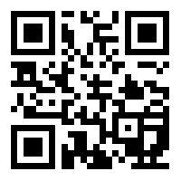
Please provide some feedback on the presentation by following the QR Code below.

